Slide 1
An Introduction to Neo4j
Over the years, relational databases have become the proverbial hammer to the storage nail. Tables, rows, primary keys, foreign keys and the always loved SQL. Relational databases like SQL Server have their place, but when it comes to relationships, you can easily slip into a world of unnecessary complexity. Thankfully, there is a better way - graph databases. Neo4j is the most popular graph database in use today. In this session, we'll discuss the basics of graph databases, how to set up neo4j, create your first database and query using the cypher query language. You'll come out of this session with an understanding of why and how you'd use a graph database to solve real world problems.

Slide 2
An Introduction to Neo4j
CodepaLOUsa
March 2016
Michael Eaton / @mjeaton
Notes:
Welcome to this introduction to Neo4j.
My name is Michael Eaton,

Slide 3

Quicken Loans

Slide 4

"In a time where organizers are censoring speakers and their content, @mjeaton and @kalamazoox is a bastion of freedom. He is a luminary." "@mjeaton @kalamazoox believes in the open exchange of ideas, however uncomfortable, and trusts humans to think, collaborate and create."
If parts of you don't change after #kalx13, you’re not listening.
Other confs are for the head, #kalx13 is for the heart.
"#kalx12 is like an All Star team of speakers. Every single one would have been the best talk at every other conference." "I've discovered @kalamazoox is a hidden gem. Today was like a braver, more profane set of dev-oriented TED talks. Lots of passion and humor."
#kalx13 part awesome insightful talks, part @mjeaton and friends roasting each other :)
When: Saturday, April 30, 2016 Where: Kalamazoo, MI More Details: http://kalamazoox.org

Slide 5
about.me/mjeaton
Notes:
About.me/mjeaton

Slide 6
Disclaimer: Enthusiast, not expert
NOT a mathematician!
Notes:
About.me/mjeaton

Slide 7
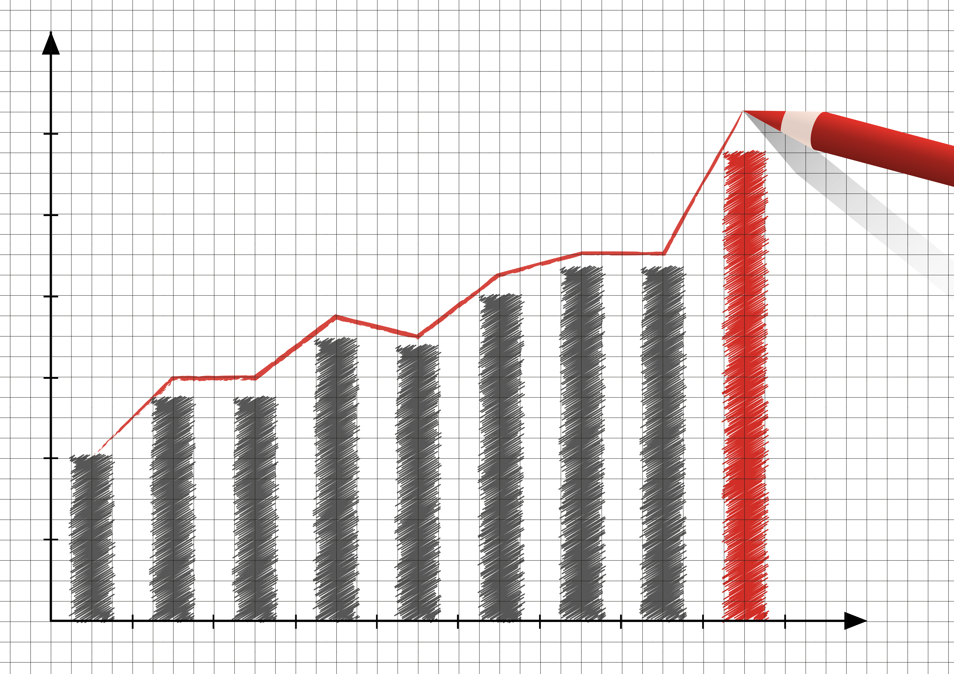
Graphs?

Slide 8

Graphs
Notes:
Relationships

Slide 9
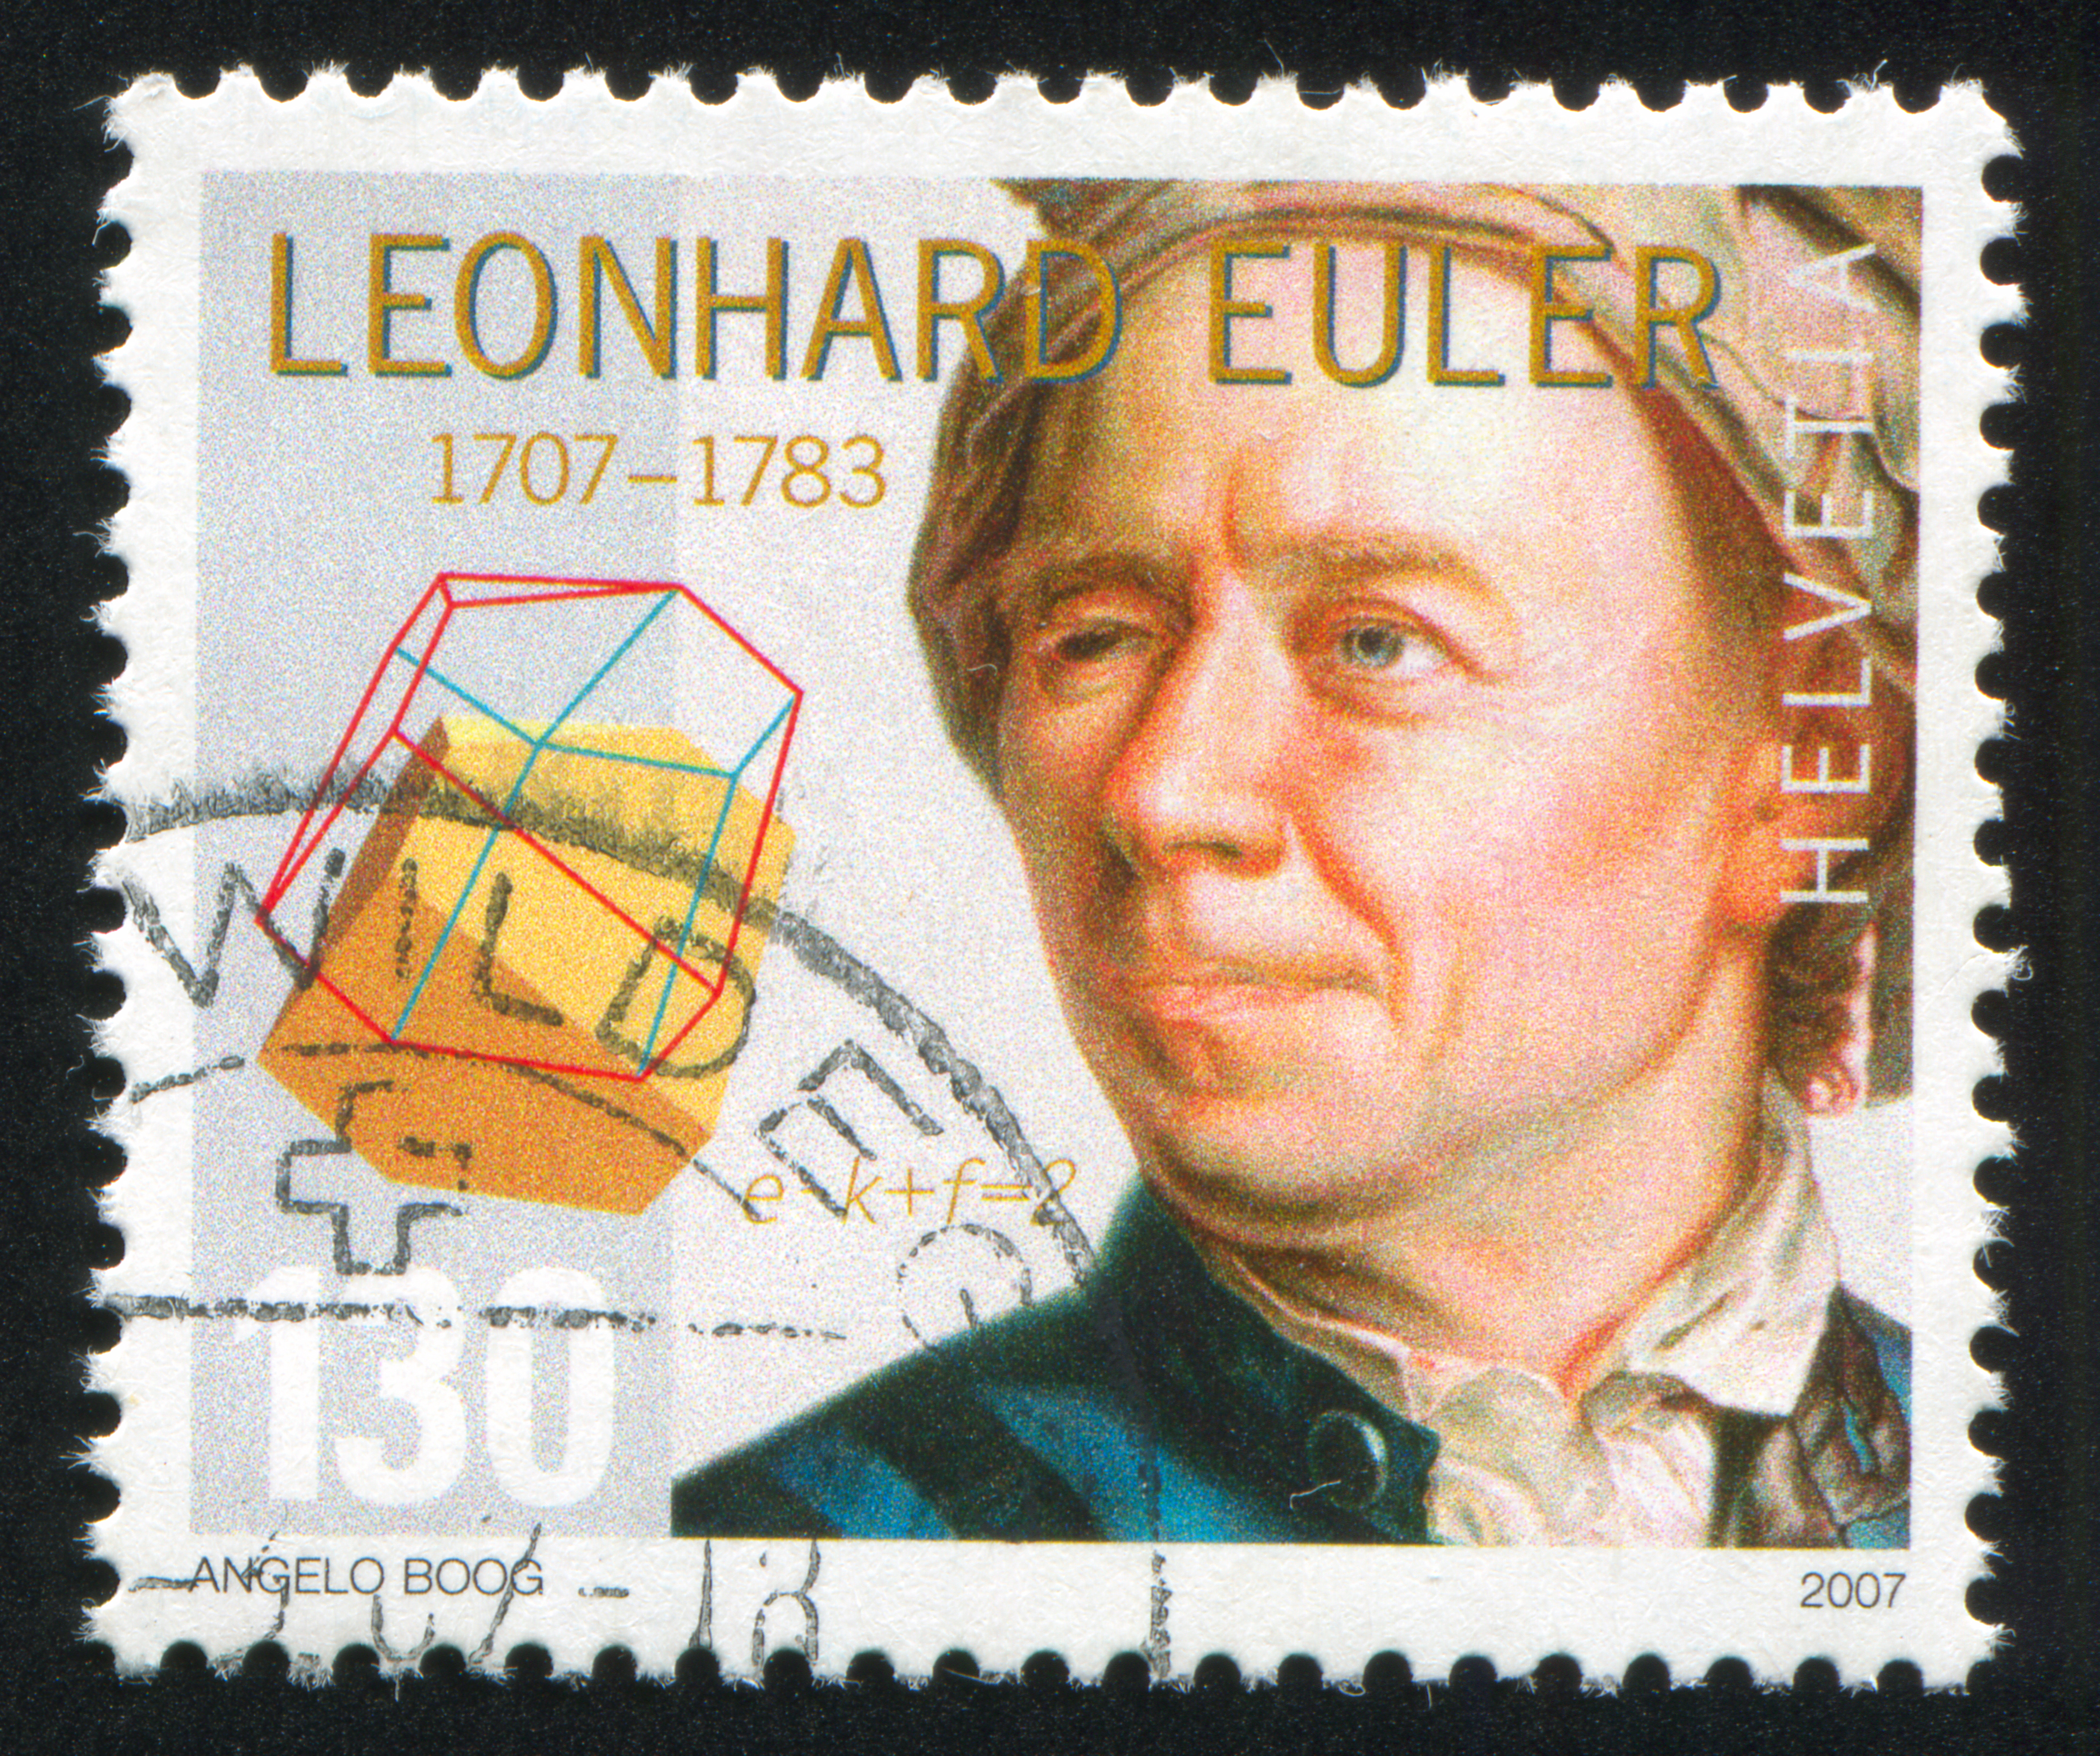
Notes:
a Swiss mathematician, physicist, astronomer, logician and engineer who made important and influential discoveries in many branches of mathematics like infinitesimal calculus and graph theory
Wrote the first paper on graph theory in 1736

Slide 10
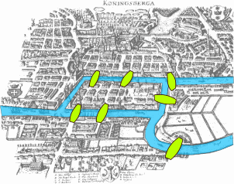
Seven bridges problem
Notes:
The problem was to devise a walk through the city that would cross each bridge once and only once, with the provisos that: the islands could only be reached by the bridges and every bridge once accessed must be crossed to its other end. The starting and ending points of the walk need not be the same.

Slide 11
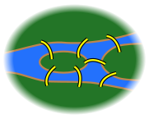
Seven bridges problem
Notes:
First, Euler pointed out that the choice of route inside each land mass is irrelevant. The only important feature of a route is the sequence of bridges crossed. This allowed him to reformulate the problem in abstract terms (laying the foundations of graph theory), eliminating all features except the list of land masses and the bridges connecting them. In modern terms, one replaces each land mass with an abstract "vertex" or node, and each bridge with an abstract connection, an "edge", which only serves to record which pair of vertices (land masses) is connected by that bridge. The resulting mathematical structure is called a graph.

Slide 12
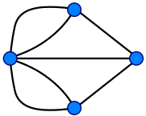
Seven bridges problem
Notes:
Since only the connection information is relevant, the shape of pictorial representations of a graph may be distorted in any way, without changing the graph itself. Only the existence (or absence) of an edge between each pair of nodes is significant. For example, it does not matter whether the edges drawn are straight or curved, or whether one node is to the left or right of another.

Slide 13
Graph theory
Vertex
Vertex
Vertex
Vertex
Edge
Edge
Edge
Notes:
graph theory is the study of graphs, which are mathematical structures used to model relations between objects.

Slide 14
Graph theory
Node
Node
Node
Node
Relationship
Relationship
Relationship
Notes:
What we’ll be talking about

Slide 15
nosql
Key-value Stores
Redis
Document Databases
CouchDB
MongoDB
Graph
Neo4j
Graph Engine
Others…
Notes:
Nosql databases
----- Meeting Notes (3/29/16 12:48) -----
Categories of nosql databases
----- Meeting Notes (3/29/16 12:56) -----
Key-value stores - an example of this would be redis
Document databases such as Couch and Mongo
Graph Databases including Neo4j and Microsoft's Graph Engine (along with many, many others)

Slide 16
Notes:
Nosql databases
----- Meeting Notes (3/29/16 12:48) -----
Categories of nosql databases

Slide 17
Graph databases
Notes:
Graph theory

Slide 18
Neo4j
Notes:
What is neo4j?

Slide 19
installing

Slide 20
browser
Notes:
Installing Neo4j

Slide 21
cypher
Notes:
Neo4j browser

Slide 22
More information
Notes:
Cypher

Slide 23
about.me/mjeaton

Slide 24
Image credits
Map of Königsberg - https://commons.wikimedia.org/wiki/File:Konigsberg_bridges.png
Bridges - https://commons.wikimedia.org/wiki/File:7_bridges.svg
Königsberg Graph - https://commons.wikimedia.org/wiki/File:K%C3%B6nigsberg_graph.svg

